Slide 1
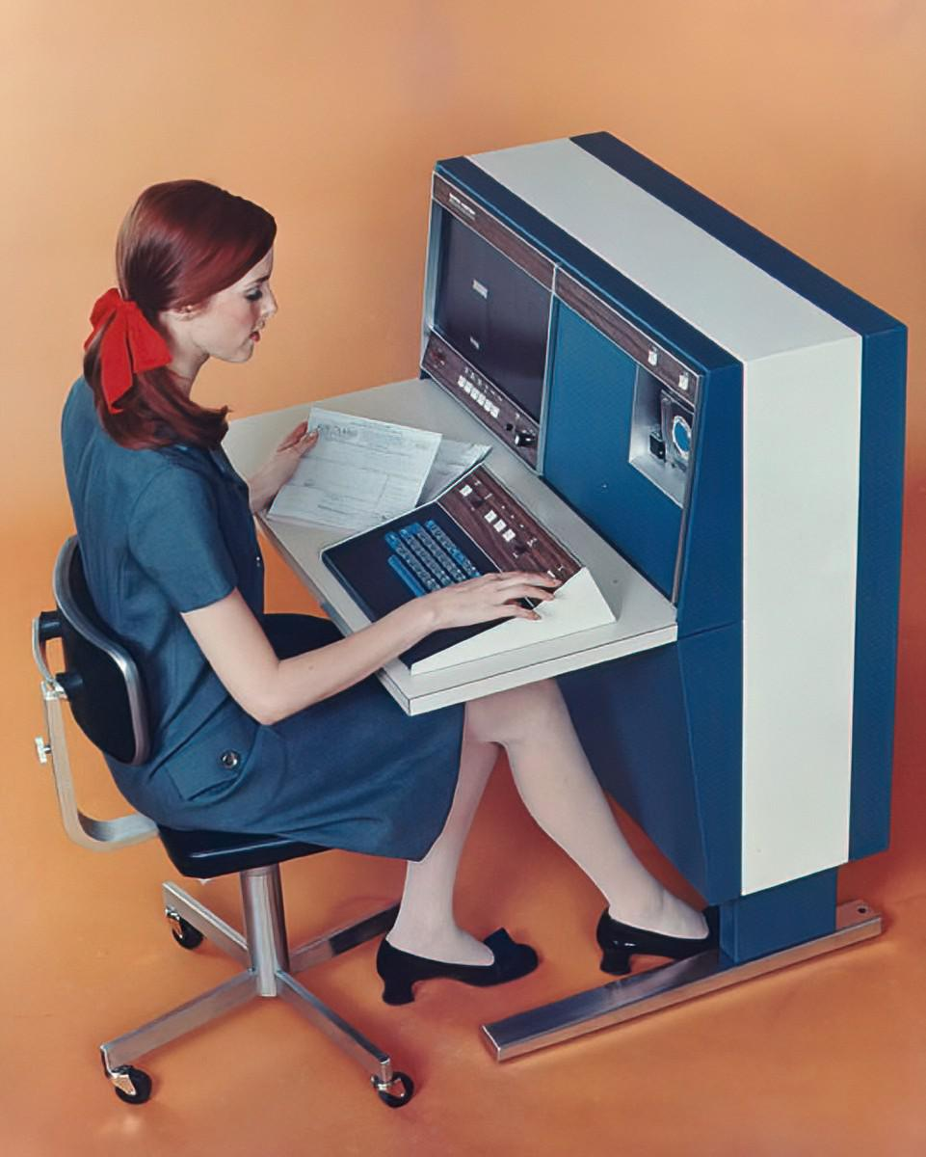
W E L C O M E
mcccc:
THE INTERNET
Notes:
Note: Italicized text is meant as commentary/instruction. Unitalicized text is meant to be spoken directly.
Activity Preparation
Play some music in the background, like this: https://www.youtube.com/watch?v=MVPTGNGiI-4
Welcome the students as they arrive
Once everyone is seated, cut the music
Introduce yourselves and provide a little background
Move to the next slide

Slide 2
Agenda
Icebreaker
Presentation
Code-Along
Customization
Site Sharing
Blooket
Notes:
Here’s what we’ll be doing tonight!

Slide 3
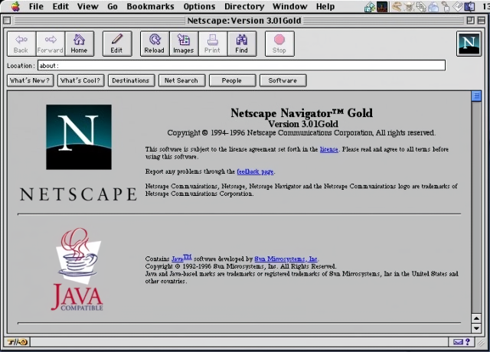
Icebreaker Activity: Explore the Old Web

Slide 4
Presentation
it’s time to learn about the web!
Notes:
Now it’s time to get into the presentation.

Slide 5
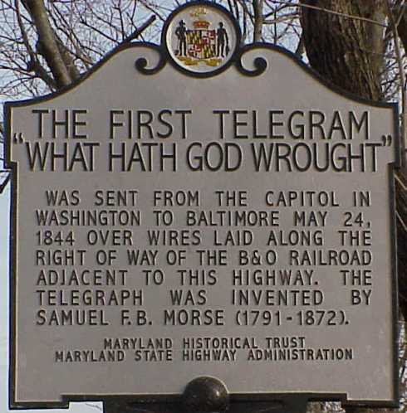

History
1844

Slide 6
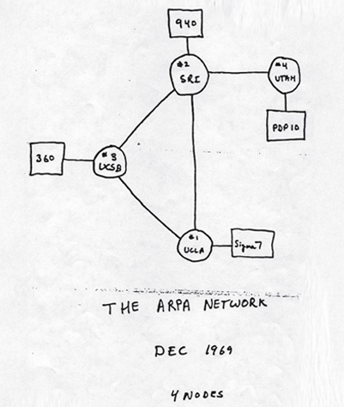
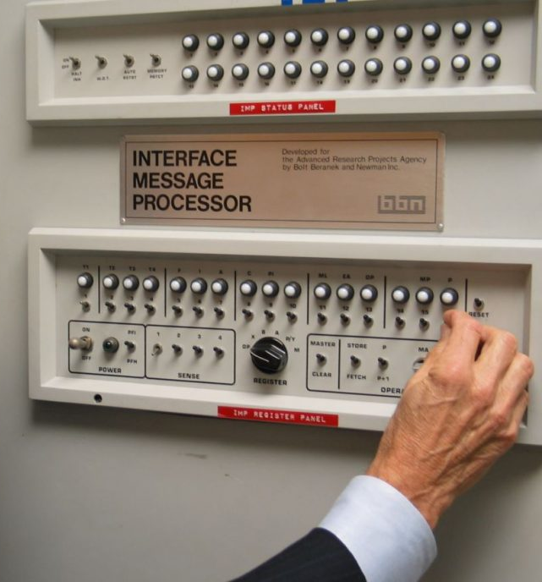
1969
1969
ARPANET
"Do you see the L?"
"Yes, we see the L," came the response.
"We typed the O, and we asked, "Do you see the O."
"Yes, we see the O."
"Then we typed the G, and the system crashed"...
Yet a revolution had begun"...

Slide 7
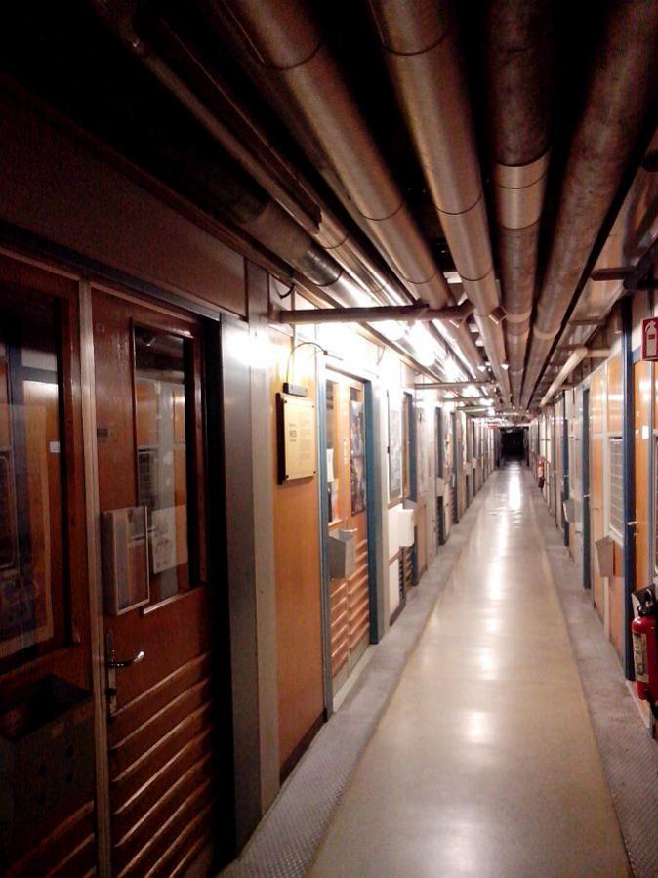


“Tim Berners-Lee was in his early 30s when he submitted the idea at work, a physics laboratory in Switzerland. He wasn't hired to create a worldwide communication system. He simply came up with the idea because he noticed inefficiencies at work.”
The World Wide Web
1989
Notes:
https://www.usatoday.com/story/tech/news/2019/03/12/world-wide-web-turns-30-berners-lee-contract-thoughts-internet/3137726002/

Slide 8
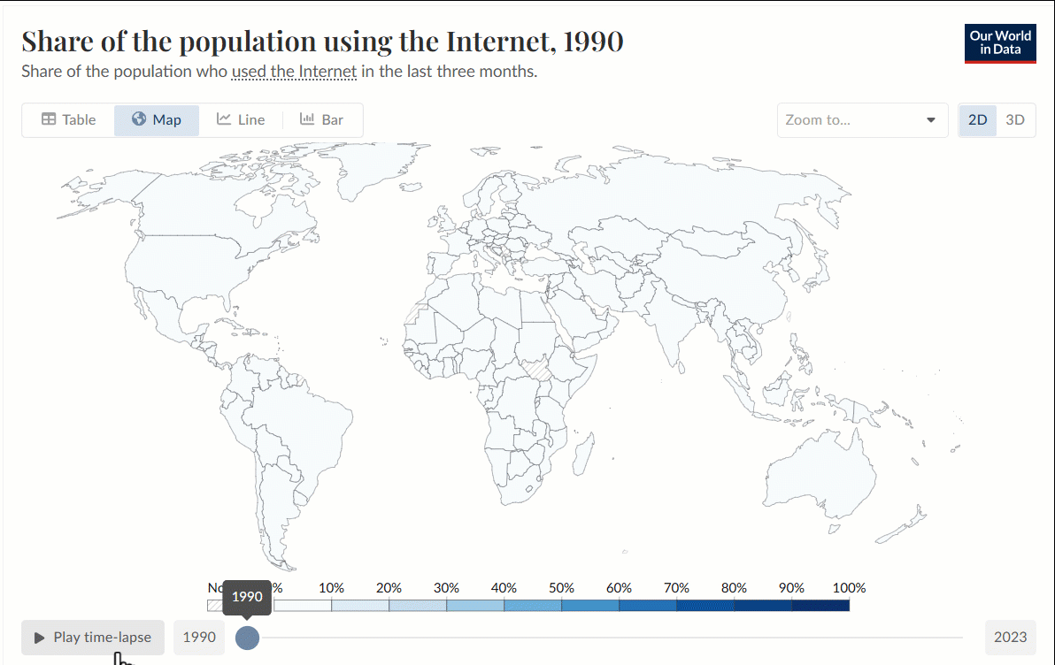

Slide 9
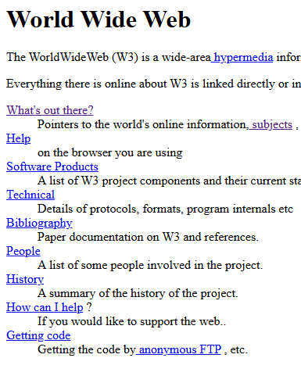

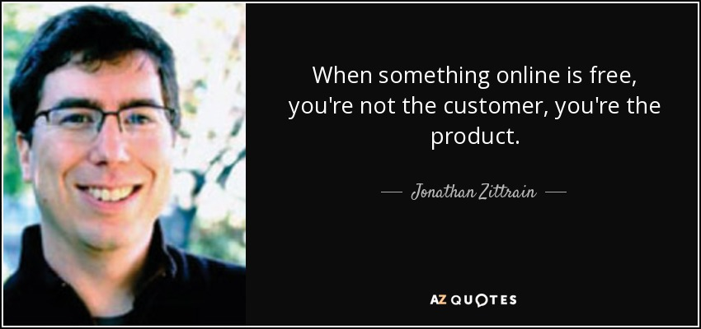
Then & Now
Addictive algorithmic feeds
Advertisements everywhere
Personal data harvesting
Bloated webpages
Centralized storage

Slide 10
Why Learn About the Web?
The internet is a big part of our lives
Knowing how it works can help you use it
You can do more than use it: you can CREATE it

Slide 11
Discussion Topics
How does the internet help society?
How does the internet hurt society?
What will the internet be like in ten years?

Slide 12
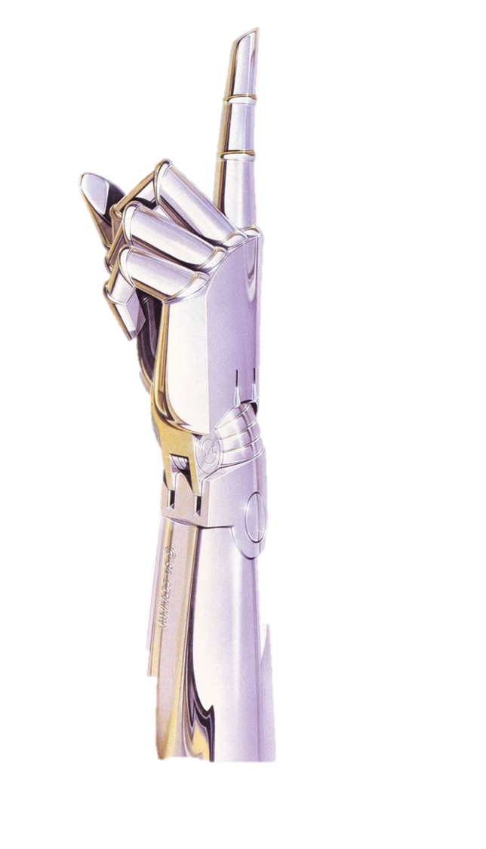
raise your hand if you have ever been to a website.
Notes:
Raise your hand if you’ve been to a website. Hopefully everybody has. What websites have you visited? Does anyone know how websites are made?

Slide 13
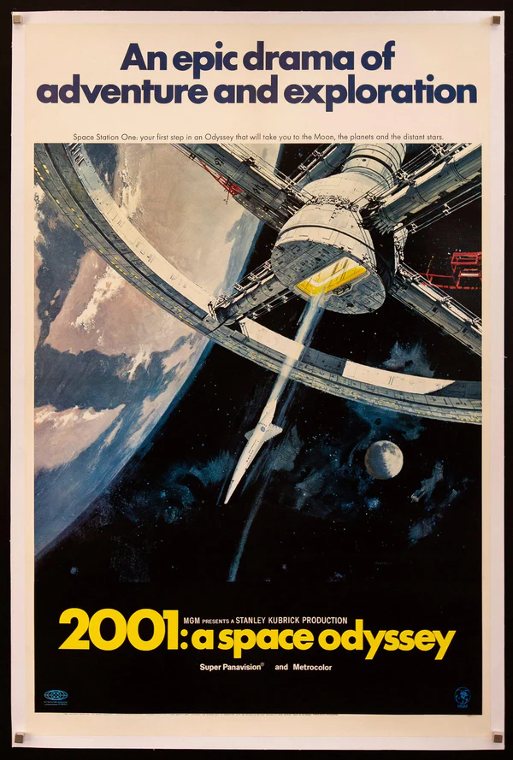
one example: Wikipedia
1. open Microsoft Edge
2. visit a page for a movie like 2001: A Space Odyssey
3. right click and select the View page source option
4. look at the HTML code that powers the site!
Notes:
Let’s take a look at an example. Has anyone been to Wikipedia before? We are going to visit a Wikipedia page, and take a look at the code that builds it. Can anyone name a movie?
Go to the Wikipedia page for a movie (or TV show, or music artist, or anything else), and follow the instructions on the slide. When viewing the source, explain that all the text is HTML code, and that the web browser (Google Chrome) interprets the code and makes it into a nice website. More info on the next slide.

Slide 14
HTML
HTML stands for HyperText Markup Language.
you can use HTML to build websites.
web browsers (like Google Chrome) take an HTML document and turn it into a nice looking page.
Notes:
Does anyone know what HTML is? Click.
It stands for HyperText Markup Language. Click.
You can use it to build websites. Click.
As we saw, web browsers like Chrome take all that garbled mess of code and turn it into a nice looking website!

Slide 15
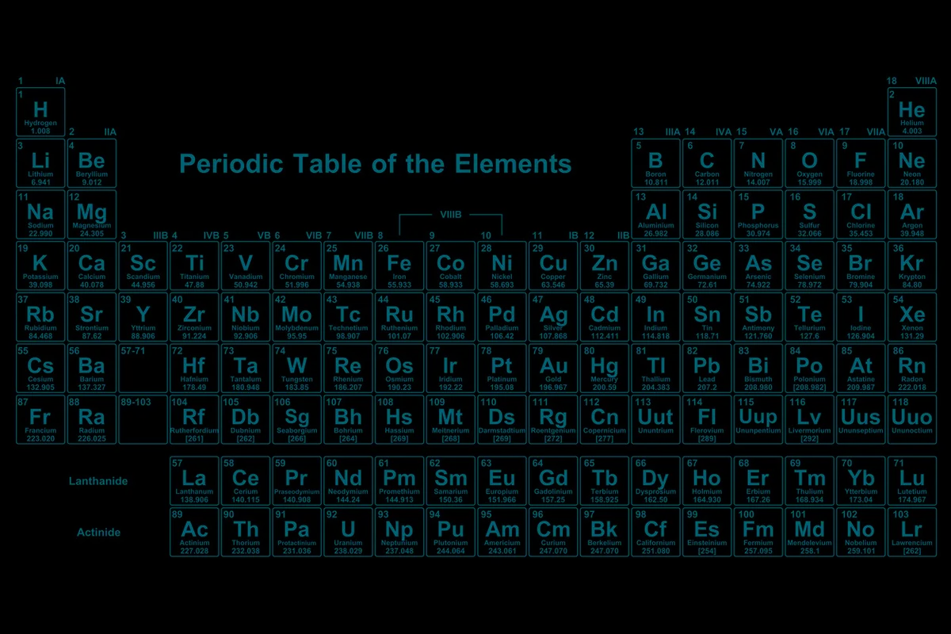
HTML Elements
what’s something you’ve seen on a website?
text
pictures
every little thing on a website is an element.
links
videos
Notes:
Now let’s talk a bit about HTML elements. Can anyone tell me something you’ve seen on a website before? Click.
Some examples are text, links, pictures, and videos. Click.
All of these things are examples of HTML elements. Elements are the building blocks of a website, and we will learn how to use some different ones to create different components on a site.

Slide 16
Our First HTML Element: A Header
<h1>Mel’s Website</h1>
< and >
Less-than and Greater-than signs
A.K.A.
Angle Brackets
Alligators
Pac Mans
<h1>
Opening tag for the element
A.K.A.
Tells HTML to start a big header element
Content
That which is to be enclosed within the HTML element
A.K.A.
The stuff inside the thing
</h1>
Closing tag for the element
A.K.A.
Tells HTML to end the big header element

Slide 17
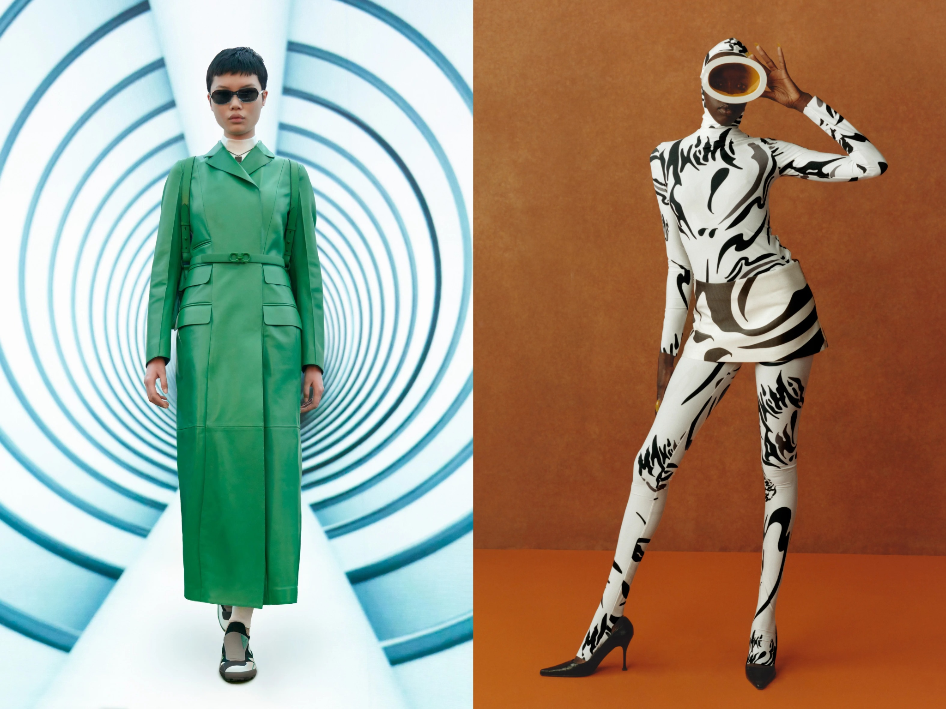
CSS Style
CSS is a language that lets you customize styles.
it stands for Cascading Stylesheets.
you can change things like colors, fonts, and sizing.
if HTML is the body of a website, CSS is the clothing that it wears
Notes:
We are also going to use CSS to add style to our websites. Click.
CSS is a language that lets you customize styles. Click.
It stands for Cascading Stylesheets. Click.
You can change the appearance of almost anything on your website, including colors, fonts, and sizing. Click.
If HTML is the body of a website, CSS is kind of like the clothing it wears - it won’t change the actual content, but it can change how it is presented.

Slide 18
Code-Along Activity
it’s time to build your own website!
Notes:
Now let’s get coding! Where exactly will we be coding?

Slide 19

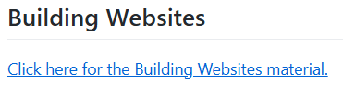
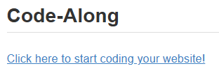
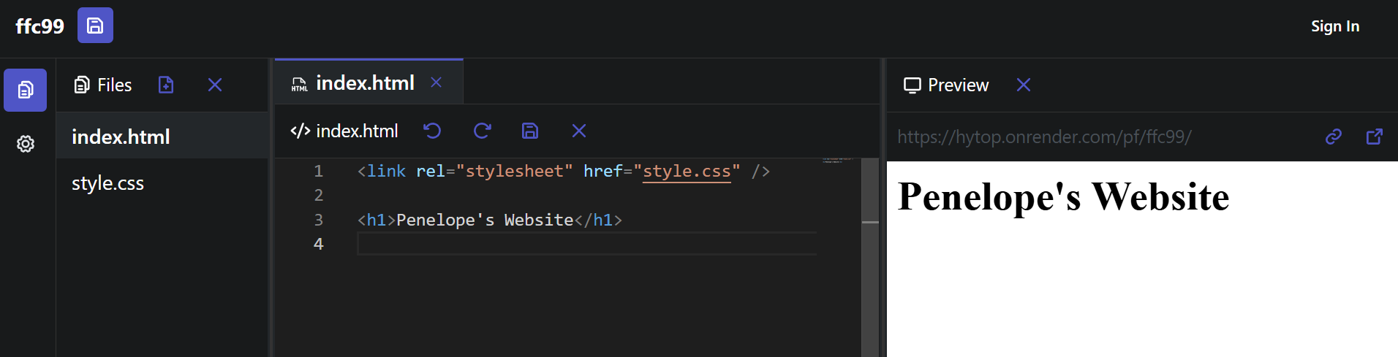
Save your Project
Pick a File
Write Code
See your Website
CHALLENGE: make it your website instead of Penelope’s!
Notes:
Now let’s do it! Click.
Go back to the lesson homepage. Click.
Under where it says “Code-Along” click the link! Click.
Make sure to open the preview pane. The preview should appear on the right. Click.
Now for your first task… try to change the name on the website so it reflects your name!
Continue the code-along following the guide.

Slide 20
Customization
it’s time to make your site your own!
Notes:
Direct the students to the Customization guide. It shows some other cool things that are possible with HTML and CSS.

Slide 21
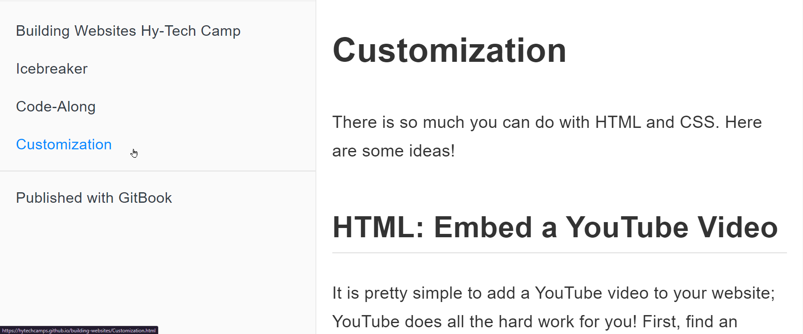
from the homepage, click on Customization!

Slide 22
Site Sharing
it’s time to share your sites!
Notes:
Show students how to share their sites.

Slide 23
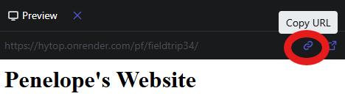
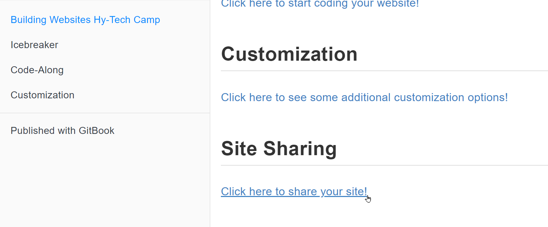
1. Get Link
2. Submit Form

Slide 24
Blooket
it’s time to see what you learned!
Notes:
End the camp with the Blooket.

Slide 25
Conclusion
thank you!
Notes:
End the camp with the Blooket.

